Slide 1
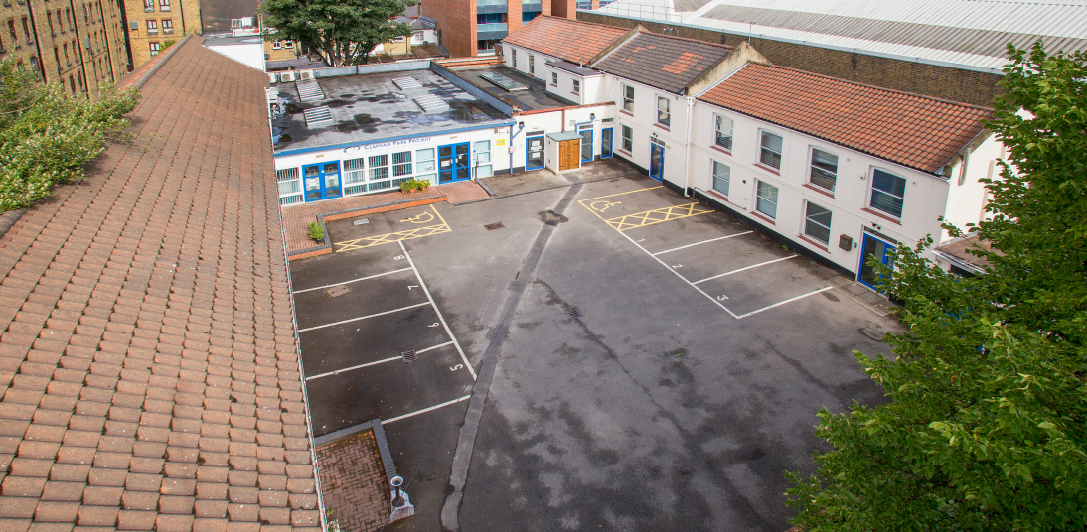
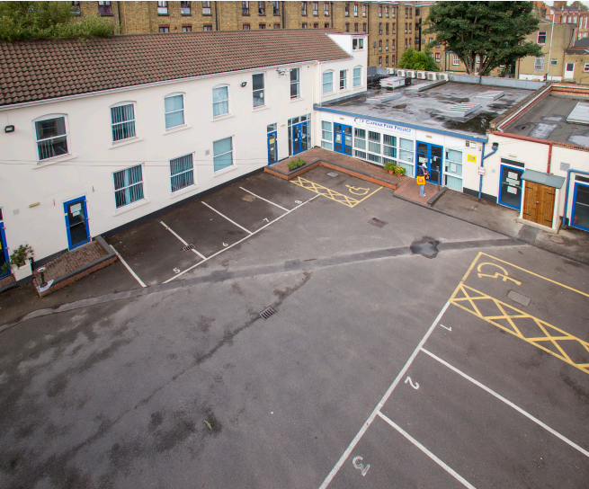
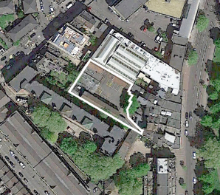
1- 4 BRIXTON ROAD SW2
Letting Summary
1,000 – 12,135 sq ft Available
For further information please contact:
Bay Fox Smith
Robert Skioldebrand M: 07769 725 412
E: robertskioldebrand@brayfoxsmith.com
Prince Frederick House
35/39 Maddox Steet
London
W1S 2PP
Jake Stace
M: 07597 685 889
E: jakestace@brayfoxsmith.com
brayfoxsmith.com

Slide 2
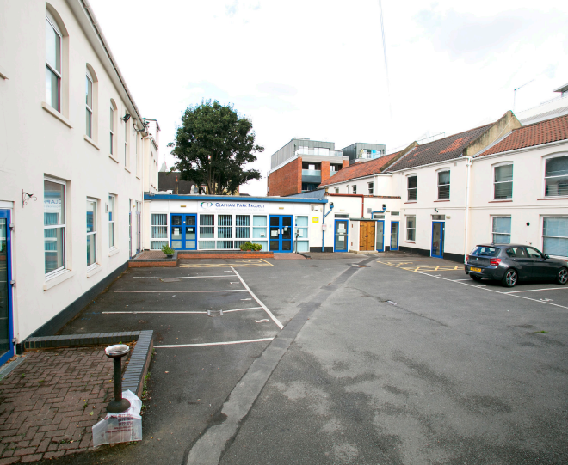
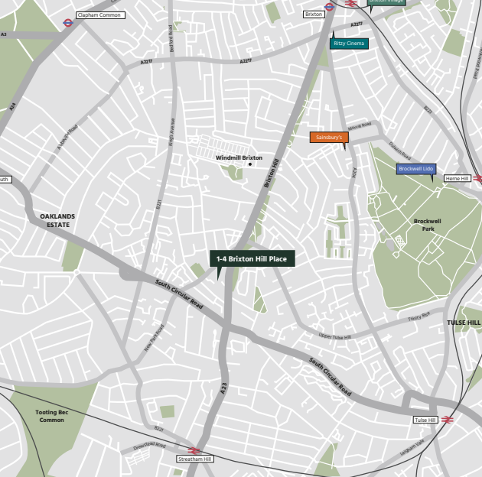
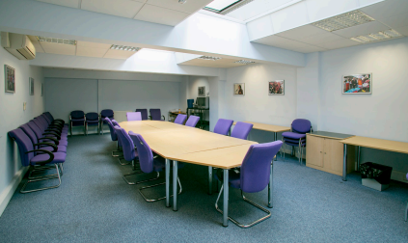
1 – 4 BRIXTON ROAD SW2
Location
The property is located on Brixton Hill, a short walk from Brixton town centre and 4.5 miles south of central London.
The property is bound by predominantly residential uses. To the north- east is a self-storage unit which is occupied by Access Self Storage.
The surrounding area is predominantly residential in character with a mix of uses along Brixton Hill (A23). The property is within walking distance to many amenities opportunities provided by Brixton, including Brixton Village, Pop Brixton and the Ritzy Cinema.
Description
The property comprises office B1 (a) use and ancillary space over ground and first floors on a site area of approximately 0.35 acres. The buildings are of brick construction with part pitched slate and part flat roof.
Accommodation
The property is predominantly used as the offices and meeting rooms for Clapham Park Project. The existing floor area extends to circa 13,152 sq ft (1,222 sq m) over ground and first floor. There is also potential to increase the floor area by a further 4,000 sq ft (372 sq m) through
Commercial Terms
Rent: POA
Rateable Value of £80,500.
Subject to contract
Robert Skioldebrand M: 07769 725 412
E: robertskioldebrand@brayfoxsmith.com
Jake Stace
M: 07597 685 889
E: jakestace@brayfoxsmith.com
MISREPRESENTATION ACT 1967 The particulars are believed to be correct, but accuracy cannot be guaranteed and they are expressly excluded from any contract.

Slide 3
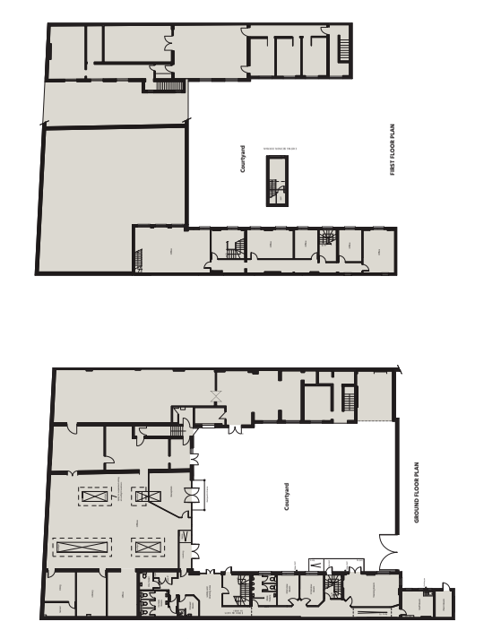
1 – 4 BRIXTON ROAD
First Floor Plan
Ground Floor Plan
Robert Skioldebrand M: 07769 725 412
E: robertskioldebrand@brayfoxsmith.com
Jake Stace
M: 07597 685 889
E: jakestace@brayfoxsmith.com
MISREPRESENTATION ACT 1967 The particulars are believed to be correct, but accuracy cannot be guaranteed and they are expressly excluded from any contract.

